Slide 1
College Credit Plus
Parent/Student Information

Slide 2
Students’ Postsecondary Credit Opportunities During High School
Articulated Credit Transcripted Credit
Secondary Career Technical Alignment Initiative (SCTAI)
CTE – Career and Technical Education
Statewide Articulated Agreement offering SCTAI courses
Bilateral Agreement offering CTE content for local articulated credit

Slide 3
All secondary college credit opportunities are not the same
Advanced Placement requires a third-party assessment, a score of 3 or above for guaranteed University System of Ohio credit upon enrollment in a USO (University System of Ohio) institution.
Articulated Credit is not recognized on a student’s college transcript until that student subsequently enrolls in a college that is authorized to confer the particular credit.
Transcripted Credit is recognized on the student’s college transcript upon successful completion of the college course. The high school student is enrolled at the college at the time the student is taking the college course.

Slide 4
College Credit Plus (CCP)
CCP replaces Ohio’s Post-Secondary Enrollment Options program (PSEO) and all alternative dual enrollment programs previously governed by Ohio Revised Code Chapter 3365.
Governor Kasich signed H.B. 487 into law on June 16, 2014.
CCP program operational 2015/16 school year.
Notes:
Higher ed – Inter-University Council of Ohio (4 yrs), Association of Independent Colleges and Universities (privates), Ohio Association of Community Colleges
K-12 – BASA, OASBO, OSBA, Ohio Association of Career-Technical Superintendents, Ohio Association of Secondary School Administrators, Ohio Association of Independent Schools, Catholic Conference

Slide 5
College Credit Plus
REQUIRES TWO FUNDAMENTAL CONDITIONS:
Student must be enrolled in both college and high school.
Student earn transcripted college and high school credit upon successful completion of the course.

Slide 6
CCP Participation
•All public districts and public institutions of higher education (IHE) must allow college-ready students, grades 7-12, who qualify for college admission to participate.
•All nonpublic secondary schools must allow college-ready students, grades 7-12, who qualify for college admission and receive state funding to participate.
•All nonpublic postsecondary schools may participate.
•Each participating IHE must consistently apply its established admission standards. In conjunction with those standards and prior to making a final admission decision, the IHE shall evaluate the student against one of the standards identified in the "Uniform Statewide Standards for Remediation-Free Status.”
Notes:
EOC exams, standardized test results, GPA, teacher recs

Slide 7
Student Qualifications
College Readiness Indicators – assessment thresholds to guarantee “remediation free” status at any public post‐secondary institution in Ohio
A student who meets or exceeds the following thresholds will be deemed as remediation free and eligible to enroll in a college credit‐bearing course at any of
Ohio’s public institution of higher education.
ACT English Sub Score 18 or Compass Reading Scale Score 74
ACT Reading Sub Score 21
ACT Mathematics Sub Score 22 or Compass Algebra Scale Score 52

Slide 8
Secondary Schools Must…
Provide program information prior to March 1 to grades 6 to 11
Provide counseling services to interested students grades 6 to 11
Verify each CCP student is not taking more than 30 college credit hours per academic year and not more than 120 college credit hours in high school.
Assure each student does not exceed full-time status. Calculate full-time status as follows:
1)Determine student’s number of high school ONLY units,
2)Multiply that number by 3, and
3)Subtract the result from the number 30.
4)That number is the total number of college credits that CCP student may earn that academic year.
Continued

Slide 9
Secondary Schools Must…
Convert college credit as follows:
Per CCP course: If 3 or more college credits convert to 1 Carnegie unit. If less than 3 college credits convert proportionally.
Weight grades as follows:
All advanced standing programs must be weighted the same within subject area. Honors classes may not be weighted higher than any advanced standing program.
Develop a process to identify students who are economically disadvantaged.
Provide (sample) Pathways

Slide 10
CCP Pathway Requirements
Each public high school must develop two pathway opportunities through CCP.
One where a student can earn 15 transcripted credits
One where a student can earn 30 transcripted credits
Pathways must be developed in coordination with at least one partnering IHE.
Pathways must be published as part of school district’s official course offerings.

Slide 11
CCP Pathway Expectations
All courses included in a Pathway must adhere to the CCP program requirements and do not have to be delivered at a high school.
Students shall have no obligation to take courses identified on a Pathway.
A pathway may:
Be organized by a major or career path
Include various core courses required for a degree or professional certification by the college

Slide 12
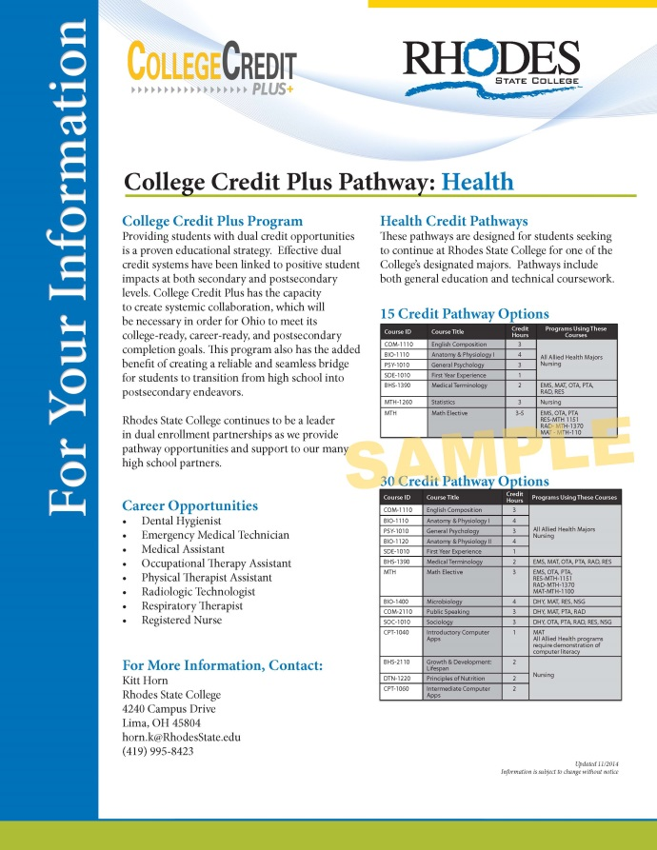
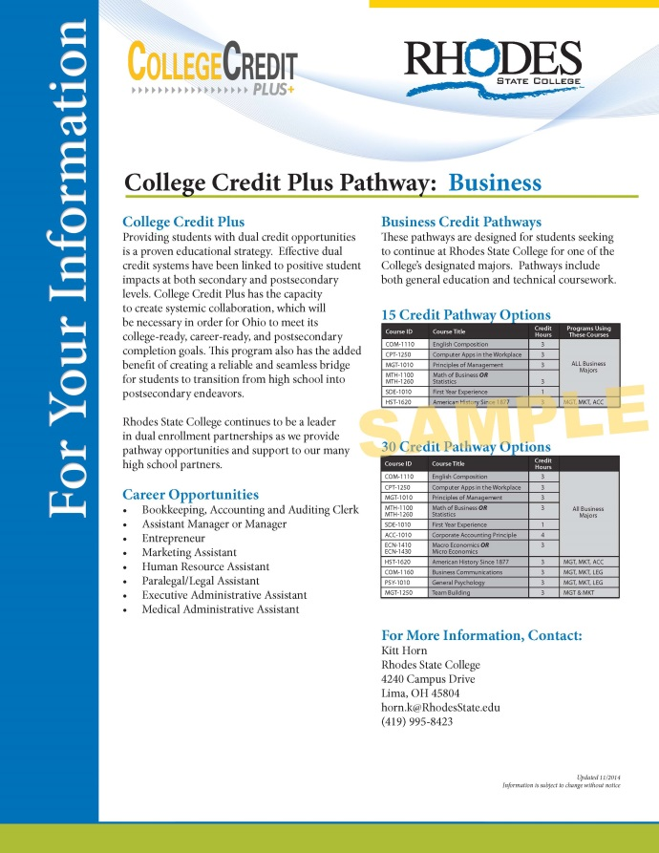
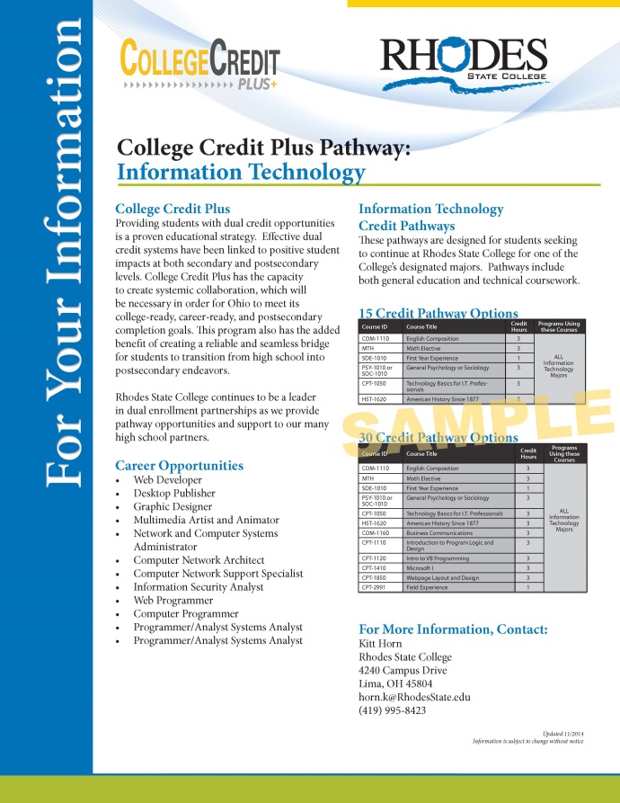
Pathways

Slide 13
CCP Courses Must…
Be the same as those offered on campus (included in IHE course catalogue)
Be nonsectarian and non-remedial
Apply toward a degree or professional certificate
Be taught by instructors who meet BOR’s
academic credential requirements
NOTE: Your High School has the option of requiring you to pay back any monies spent on courses that are failed or dropped after the 100% drop date.

Slide 14
Benefits… Perspective
It is important to know why you are participating in this program.
Are you taking courses to:
~Continue at your College Credit Plus college or university?
~Transfer to another institution?
~Explore a major or area of study?
TAG and OTM Course Selection (Creating Pathways)
You may use www.transferology.com and/or speak to an academic advisor to determine how PSEOP courses will transfer to another college or university.

Slide 15
For More Information:
https://www.ohiohighered.org
http://education.ohio.gov
Contact:
Kitt Horn, Off-Site Coordinator
(419) 995-8423
Horn.K@RhodesState.edu

